Slide 1
B4P Beyond Former Performance.
A powerful programming language and analytics engine
enabling rapid transformation of big data into powerful insights
Transforming Big Data to Powerful Insights
Release 8.00 2021-01-05 "Friedrich Dürrenmatt”
Image source: Amir Hanna, Rush Hour in Dubai / UAE, unsplash.com. F. Dürrenmatt: 100th Anniversary at release date
Copyright © 2007 – 2021 by Georg zur Bonsen, Baden / Switzerland

Slide 2
B4P Execution and Analytics Engine Overview
Multiple Complex
Data Sources
Comprehensive analysis
generated in seconds
B4P Execution and Analytics Engine
databases
B4P
Excel
data files
Web browsers
web data
B4P
Interactive
processing
Batch
Programs
data files: Excel, XLS/XLSX, CSV/TSV, XML, JSON, HTML, MHTML, Zip, Text
databases: Salesforce, Oracle, SAP, Access, …
web data: Data from any Internet accessible source

Slide 3


B4P Problem Statement Conventional methods do not address challenges of data management
Start with your task
Possible Solutions ?
Gather the Data from databases, tables, Internet, manually, etc.
Cumbersome Exported Data from databases if used directly to work with (e.g. limited formatting)
Write Excel Macros:
OK for simple tasks, but cumbersome code and very slow when doing sophisticated work on big data. E.g. combining 2 tables into 1 creates a lot of effort !
Visual Basic macros can become sophisticated and deliver poor performance
Write a Computer Program (C, Java, Python):
Custom software will get the job done very fast after you have spent significant time to write the program, debug it and get it running. Difficult for others to understand.
Program text tend to get very big. You need to worry about every functional detail. And it takes a lot of time.
You need good programming know-how, including object oriented programming, and a suitable development environment with language compiler.
High performance, but very elaborate task until you have finalized your program
Hire a Consultant or two:
Consultants are happy to solve your problems against cash. They will offer decent solutions.
If you need further enhancements in the future, they ask for more cash. You will depend on them. And bother your boss to get further spendings approved.
Money and time required until one problem solving has been accomplished
Foreign Chars lost, e.g. M?nchen
Incompatible data formats! Excel cannot read it in or use it directly, data alignment needed. E.g. locality of numbers, dates.
Verify the data manually or semi- automatically on Excel
Missing data, manual corrections and filling gaps
Combine Multiple Info Sources in order to see the big picture effectively, do various lookups
Compare New vs Old data on Excel. Time-consuming analysis of multiple lists along the timeline
Excel is slow with big data when loading and processing (3’000 … > 10 M rows)
Condense and align the data, do necessary sorting, build pivot tables, etc.
Do needed calculations in order to come closer to the results and verify them
Add Formatting and Style on the results, incl. comments, etc.
Work done (past due date, poor quality)

Slide 4
B4P Solution Automate manual data integration and management
Derive smart results from many sources
Issue: Repeating and time-consuming manual work
Downloading several files from different databases (many mouse clicks, etc.)
Checking and cleaning up data received
Resolving data inconsistencies
Efforts to collect missing information and to fill up gaps (e.g. interpolation)
Repetitive manual steps to combine and align the data from multiple sources using on Excel and similar tools
Risk of doing mistakes with all the manual efforts
Doing consistency checks of the current data and identifying the changes you did in the previous reporting period
Hand-tailored Excel macros going on strike in case of minor data changes
Poor Excel performance with very large data sets
Wasting time waiting for poorly performing software / macros to complete the work
Time-consuming efforts to undertake any other information refinements like: - Doing some pivot tables - Creating some statistics - Creating time plans (e.g. production plans) - Eliminate information considered redundant - Making information ready for good visualization - Shaping up the data with style to make results easy to read.
Database
Exports
Excel tables
Lookup tables
Templates, etc.
@
Internet Data Sources
User input
Check, combine and consolidate the
information to get results you need
Update
Databases
Output Tables
and reports
(Excel, HTML,...)

Slide 5




B4P Solution Automate your processes to overcome all pain points
Start with your task
B4P – Execution Engine and Language
Gather the Data from databases, tables, etc. automatically
Based on 12 years of commercial experience!
The Language
A simple, easy to read, easy to learn syntax
Key strengths on large structured data tables and hierarchically structured data sets
Very powerful feature set and large function library
Compact formulation methods for powerful processing steps Use loops and variables as little as possible.
Many problems can be solved using a few statements only.
The Execution Engine
The lean architecture of the engine delivers full machine performance "on bare metal"
Supports various data formats (Excel, HTML, XML, JSON, text files, etc., full UNICODE)
Delivers accurate results reliably
High performance even with big data – Matter of seconds, not minutes or hours
Supports styled and formatted output for Excel and HTML (e.g. colors, multiple Excel sheets, ...)
Process the Data Automatically, reliably, and very rapidly with B4P
Gaining speed !
Taking seconds !
Excellent work done on time

Slide 6
B4P Execution and Analytics Engine
Multiple Complex
Data Sources
Comprehensive analysis
generated in seconds
B4P Execution and Analytics Engine
databases
B4P
Excel
data files
Web browsers
web data
B4P
Interactive
processing
Batch
Programs
data files: Excel, XLS/XLSX, CSV/TSV, XML, JSON, HTML, MHTML, Zip, Text
databases: Salesforce, Oracle, SAP, Access, …
web data: Data from any Internet accessible source

Slide 7
B4P The Execution Engine – A Typical Workflow
Load
the raw data
Explore & Check
Clean up
Merge data
Do some
lookups
Process
and align
Final
Finish
Save
the work
From files, databases and the Internet
Excel
JSON
HTML, XML
CSV, TSV, ...
Text files and many more
Identify and extract data you need
Check all headers
Identify data
Resolve inconsistencies
Fill information gaps
Interpolating missing values
Identify and resolve duplications
Harmonize keywords and values
Align headers and overall structure
Align different number formats
Align deviating terminologies
Combine data from multiple tables
Eliminate redundant data
Enrich the information value in your tables
Consolidate
Analyze
Calculate
Pivot
Align
Sort
Sort and arrange rows and columns
Add style, formats and colors
Excel
HTML, XML
JSON
CSV, TSV
Text files and many more

Slide 8

B4P Supported Data Formats
Inputs
Outputs
Excel
XLSX, XSLM, open formats
CSV comma and tab separated files
Database Exports
HTML, MHTML and XML formats (depending what the database is producing). Examples: Salesforce, Oracle, SAP
JSON files (JavaScript Object Notation format)
CSV comma / tab / semicolon / ...symbol separated files
Other Inputs
Files with fixed columns on every row
Any other form of structured text files
ZIP files (B4P does data decompression)
Character Sets (both input and output)
UNICODE UTF-8 and UTF-16; Basic and extended multilingual planes
Legacy formats (like ASCII / Windows West Europe)
Unformatted Output for Excel
CSV comma separated files
Formatted Output for Excel (with colors, formatting and style)
XLSX (Excel 2007 onwards, in use today)
XLS (Excel 2003 XML format
Unformatted and formatted output for Browsers
HTML (incl. colors, formatting and style)
XML (planned)
Output for other databases
.csv comma / tab / semicolon / ... symbol separated files
JSON files
Plain text files
ZIP files (B4P does data compression)
Additional data formats can be supported on request, e.g. with a B4P library extension

Slide 9
B4P Use Case Information interchange between multiple different databases
Lookup Tables
e.g. official
exchange rates
ERP
Site 1
B4P
CRM Cloud
Database
ERP
Site 2
Example 1:
Information about new orders booked into the ERP system will be reported to the CRM system in order to mark the opportunity as "ordered".
Example 2:
Key dates (e.g. planned order date, delivery dates) for the same opportunity or order are different in the CRM and ERP system.
Report the differences, and, if allowed, use automated rules to resolve the inconsistencies
Data Xchg Reports
(e.g. changes, inconsistencies)
ERP = Enterprise Resource Management Databases (e.g. SAP, Oracle, BAAN, Abacus)
CRM = Customer Relationship Database (e.g. Salesforce)

Slide 10


B4P Use Case Heterogeneous data integration and cleanup from different sites worldwide
Site 1
Europe
Data
Collection
1. Load all Demand Files
The data from the different sites originate from different databases. Some sites do a manual preparation or preconditioning of the exported data
Site 2
Europe
Data Pre-
Cleanup
2. First Clean-Ups
Harmonize data formats to week numbers and years
Site 3
America
Align
Products
Vendor + Product
List
3. Product Alignment
The revolving table manages the products to include and allow for using harmonized product names.
Orientation is by common product identification number.
Site 4
Asia
Align
Projects
Project
List
4. Project Name Alignment
Different project names and/or abbreviations are used by the sites. They will be aligned.
Associated info (e.g. project numbers) can be included.
Site 5
Asia
Planning
Table
5. Project Name Alignment
The sequential list of individual demands is transformed to a horizontal planning table with weekly schedule.
Information consolidation and summing up
Optional: Import supplier data
Supplier Data
6. Import supplier planning data
If supply info is available, then match demand with supply info (e.g. delivery plans) and add to the table
Site 6
Asia
Supplier Data
Create final
reports
Supplier Data
7. Reports
Detailed report for internal use for performance monitoring
Condensed reports for vendors
The regions manage their data in different
databases systems or manually with Excel
Supply Chain
Demand Reports

Slide 11

B4P Use Case Enriched Business Intelligence
Orders List
from CRM database
1. Load orders list
Load the files and make the numerals suitable for processing (e.g. removal of thousand separators)
Filter
2. Filter
Delete orders not of interest
Delete orders with 0 EUR values
Treat opportunities of different natures individually
Expansion
6. Expand
Expand opportunities with multiple equipment suppliers into multiple rows and list the suppliers separately
7. Derive Propulsion Values
Derive equivalent equipment values
Plausibility checks + adjustments against upper and lower boundaries.
3. Preparations
Replace long names by short harmonized company names
Align product prices so they represent similar scopes, all converted to EUR
Equipment
Supplier List
with short names
Preparations
Final Cleanup
8. Final cleanup
Keep and rearrange columns of interest, discard the rest
Numeric output in easy-to-read commercial format
Exchange Rates
4. Consolidation
Identify multiple rows with same opportunity numbers (as they cover different product & service scopes)
Proper handling of traditional OEM business, consortia setups and equipment business
Consolidation
Ouput: Market
Intelligence Data
Use Excel to visualize
Market development over time
Market development across regions
Market share among suppliers
Identifying market disruptions
etc.
Scaling Factors
Corrections
5. Do some corrections
Make corrections if orders given to competitors appear over- underpriced in order to eliminate distortion
Plausibility check of values of sub-system scopes vs. the whole.
x
✓
ERP = Enterprise Resource Management Databases (e.g. SAP, Oracle, BAAN, Abacus)
CRM = Customer Relationship Database (e.g. Salesforce)

Slide 12
B4P Language
Simple procedural language
Very easy to read and understand the code, therefore very easy to learn programming.
Powerful language semantics keeps your program short to solve the problem.
Very quickly to get your code running
Be natural and less cryptic. Giver your variables, tables, functions, etc. natural names (spaces are allowed !)
Tables of any size are one of the main data storage models and B4P is optimized for this.
No programming bureaucracy such as type definitions, declaring all the variables and doing memory management on your own.
Significantly less need for fine grained programming like formulating loops, using variables, coding detailed algorithms, etc.
B4P understands data formats such as Excel, HTML, XML, JSON, CSV, etc. to retrieve data from Excel, database and the Internet directly
The execution engine and all libary files are very light-weight and lean, very robust and start quickly.
High focus on cross-platform portability (Windows, Linux, MacOS, etc.), enabling to run the same code on different platforms.
B4P output files for Excel with style and formatting like colors, row widths, etc.
Rich B4P function library with ca 800 functions, including 200 functions for processing tables, and growing.

Slide 13
B4P Language Syntax and Semantics
Overall language block structure similar to C / C++ / Java
Full and homogeneous UNICODE support
Tables and variables are the two main data storage mechanisms.
Table names, variable names and function names are fully flexible, e.g. multiple words and spaces are allowed.
Dynamic variable tree, allowing to build up nested arrays and structures
Code pieces can be passed as function parameters which will be executed multiple time or on a on-demand basis Example: table process (...), pick if (...) Benefit: Eliminates need to write loops or other details
Numerous flexible control flow mechanisms, going beyond the common ones like if, while, for, ...
File names with directory paths are understood and interpreted correctly in other platforms (e.g. Windows vs. Linux)
Powerful parameter set and matrix operations to process big data
When you program, think big:
Hint 1 Use the rich B4P function library to process these tables and big data. Large tables will be analyzed and processed at naked machine performance.
Hint 2 Use deep operations (vector and matrix operations) to process large amount of data inside tables and parameter sets.
Hint 3 Think how you can formulate your code in a very compact manner without compromising comprehensibility. Doing the great things with 5 - 20 lines of code is within reach.

Slide 14


B4P Program Example 1 Merging 2 Tables – Problem Statement
Soccer Membership List.xlsx
Football Membership List.xlsx
A new football club should be created after merging two existing sports clubs:
Merge the two tables into one table
The tables of the two clubs are arranged differently.
Some people are members in both clubs. They need to be resolved properly
Highlight possible inconsistencies
Image sources: lsc-fussball.ch, news4santonio.com

Slide 15
B4P Program Example 1 A simple program merging 2 tables – 15 statements, 0 variables, 0 loops
Simple statements
easy to understand
No loops. Simple statements applied for the whole table
Excel file loaded with
one single statement
Multiple words allowed for readability + flexibility
// A small demonstration program showing how Excel files (.xlsx) are read, processed and saved, including some style.
include ( Style Library ); // Include this library if you want to use the 'table style ...' functions.
table load excel file ( football club, Football Membership List.xlsx );
table load ( soccer club, Soccer Membership List.csv ); // Beginners are Novices here
table rename column headers ( football club, { Family Name, City }, { Last Name, Town } );
table process selected rows ( soccer club, [Level]==Novice, [Level]=Beginner );
table merge ( football club, soccer club, { Last Name, First Name }, { Level, Town }, append, " or " );
table sort rows ( soccer club, { Level, Last Name, First Name });
table rearrange columns ( soccer club, { Level, First Name, Last Name, Town } );
// Done processing. Before saving to Excel fie, do some formatting.
table style table ( soccer club, sheet, column width, 20, row height, 20,
freeze rows, 1, autofilter, 0, vertical align, center );
table style rows ( soccer club, 0, sheet, boldface, true, fill color, gray 15 );
table style columns ( soccer club, Level, sheet, column width, 30 );
table process selected rows ( soccer club, ([Level] = '*Questionable*'),
table style cells ( soccer club, Level, row(), single, text color, red ) );
translate style attributes for excel (soccer club);
table save excel file ( soccer club, Soccer Club, New Soccer Club Membership List.xlsx );
echo ("New soccer club has ", table length( soccer club ), " members. Enjoy playing.");
1 statement merges
2 tables as specified
7 Statements to combine the clubs
7 statements to add
some formatting and
save the work.
The result is ready for
presentation

Slide 16
B4P Program Example 1 Merging 2 Tables – The Result
New Soccer Membership List.xlsx
The Result
Club members merged
Sorted by qualification
Inconsistencies highlighted (different color)
Top row frozen and autofilter feature provided
The function table merge (...) has resolved deviating information of the same persons. Example: See last row on level and town.

Slide 17
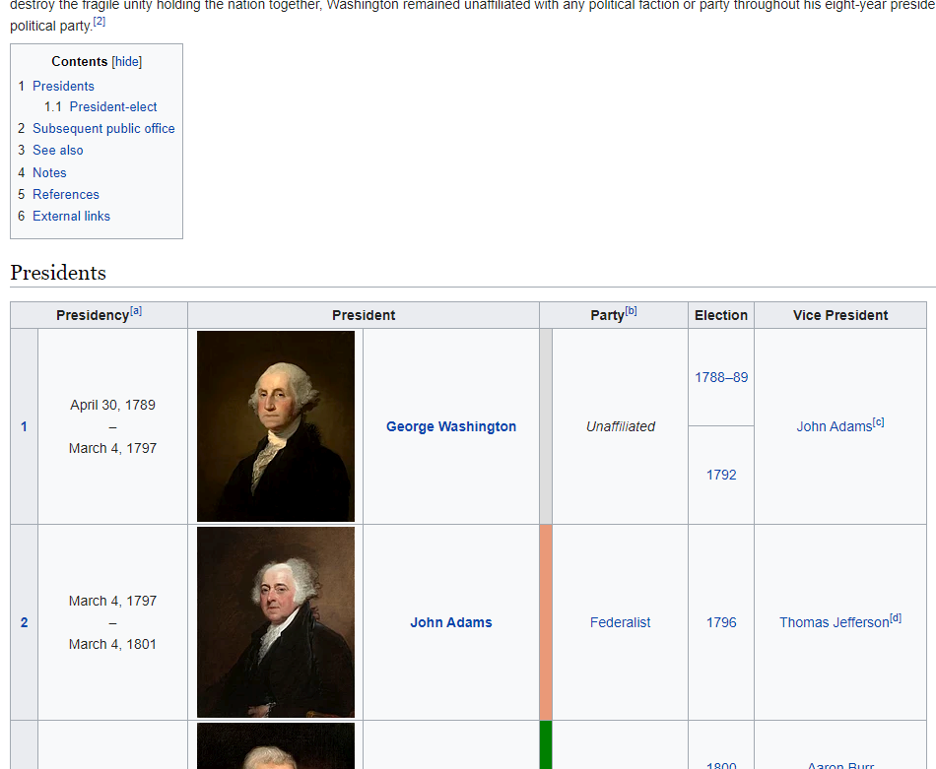
B4P Program Example 2 U.S. Presidents from Wikipedia
Download and structure the data, 1 President per row
Some presidents have multiple terms
Ignore the portraits
Some vice presidents have deviating terms
Import and clean up the data
Generate a clean Excel file for further use
Web source: https://en.wikipedia.org/wiki/List_of_presidents_of_the_United_States

Slide 18
B4P Program Example 2 18 Statements, 0 loops and 0 variables to straighten up the Presidents
include ( Style Library ); // This library needs to be included if you want to add style and formatting to the table
file download overwrite ( "https://en.wikipedia.org/wiki/List_of_presidents_of_the_United_States", presidents.html );
table load ( presidents, presidents.html, HTML, 'id="Presidents"' );
table save ( presidents, presidents as loaded.csv );
table delete rows ( presidents, table length( presidents ) -1 ); // Remove last row with redundant footnote info
// Strip out all footnote references and new lines in the fields
table process all cells ( presidents, [.] = replace all( literal([.]), { "[a]" .. "[z]", new line}, '' ) );
// Remove the blank column originally containing portraits and put president name into all rows
table delete columns ( presidents, {President, Party } );
table rename column headers ( presidents, {"President (1)","Party (1)"}, {President, Party} );
table fill vertically ( presidents, President );
table consolidate ( presidents, President, { Election, Vice President }, append, ", " );
table initialize ( party colors, // Define party colors
{{ Party Name, Colors },
{ Democratic, "#8080FF" }, // Light blue
{ Republican, "#FF8080" }, // Light red
{ Federalist, coral },
{ "Democratic- Republican", excel light green },
{ "Democratic-Republican", excel light green },
{ Whig, yellow },
{ National Union, ocre },
{ Unaffiliated, gray 15 } } );
// Add some colors and styles
table process ( presidents, table style cells( presidents, Party, row(), single,
fill color, [party colors : Party Name, [Party], Colors ] ) );
table style columns ( presidents, { "Presidency (1)", "President", "Vice President" }, sheet, column width, 30 );
table style columns ( presidents, { Party, Election }, sheet, column width, 20, horizontal align, middle );
table style rows ( presidents, 0, table, boldface, true );
table style table ( presidents, sheet, wrap text, true, autofilter, 0, freeze rows, 1 );
translate style attributes for excel ( presidents );
table save excel file ( presidents, All U.S. Presidents, presidents.xlsx );

Slide 19
B4P Program Example 2 Presidents – The Result
45 Presidents with 18 Statements
1 President per line
Data is provided in a clean format
Parties are highlighted in different colors
Waiting for the 46th entry to come soon !
. . .

Slide 20
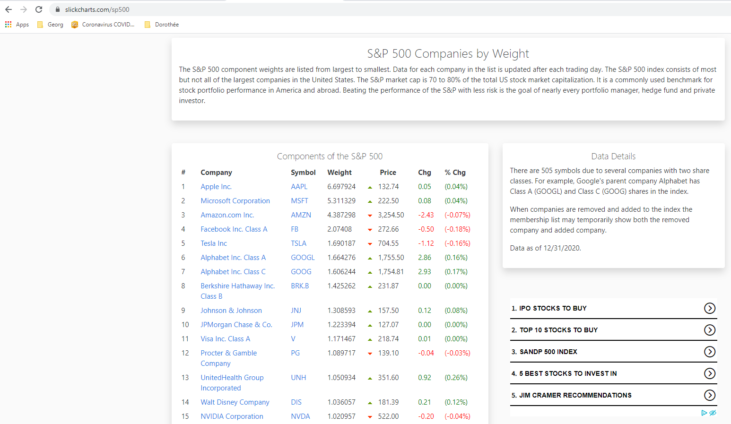
B4P Program Example 3 Stock Data (SP 500 and NASDAQ 100) Combined
Import SP 500 and NASDAQ 100 Stock Market Data from the Internet.
The illustration on the left shows the first few SP500 stock market listings.
No manual preparations required on the downloaded web contents.
Some companies are listed in both markets, others in just one of them.
Combine the data into one table
Web source: https://www.slickcharts.com/nasdaq100, https://www.slickcharts.com/sp500

Slide 21
B4P Program Example 3 21 Statements, 1 loop and 1 variable do the Job
include ( Style Library );
// Step 1: Download two web pages.
for all parameters ( {nasdaq100, sp500} , listing[] )
{
file download overwrite ( "https://www.slickcharts.com/" + listing[], listing[] + .html);
table load ( listing[] ,listing[] + .html, HTML, "Components of the" );
table rename column headers ( listing[], "Weight", "Weight " + listing[] );
// Weight info is specific to SP and Nasdaq, so add the listing name
table save ( listing[], listing[] + " as loaded.csv" );
}
// Step 2: Combine the two tables
table merge extend columns ( nasdaq100, sp500, Symbol );
table rename ( sp500, stocks );
// Step 3: Cleanup
table correct headers ( stocks, '*Price*', Price );
table rearrange columns ( stocks, { '#', Company, Symbol, Price, Chg, '% Chg' } ); // Weightings follow afterwards
// Percent value gets converted to regular number, price value is claned up
table process ( stocks, ['% Chg'] = smart numeral( middle( ['% Chg'], '(', ')' )); [Price] = clean numeral([Price]) );
table sort rows ( stocks, Company );
table process ( stocks, ['#'] = row() );
// Step 4: Add some color
table process ( stocks,
table style cells ( stocks, {'Chg','% Chg'}, {2:row()}, single, text color, select if ( [Chg]>0, excel green, red ) ) );
table style rows ( stocks, 0, table, fill color, gray 14, boldface, true, wrap text, true );
table style columns ( stocks, Company, sheet, column width, 30 );
table style columns ( stocks, '% Chg', sheet, number format, "0.00%" ); // Value to show as percent.
table style table ( stocks, sheet, freeze rows, 1, autofilter, 0);
// Step 5: Save the artwork
translate style attributes for excel ( stocks );
table save excel file ( stocks, "NASDAQ and SP500", Stocks.xlsx );

Slide 22
B4P Program Example 3 Stock Market Data - Results
Done with 21 B4P statements:
Sorted by alphabetically by company name
Both SP and Nasdaq weightings are listed.
Percentages are shown in Excel as numeric data using percent number format
Header row highlighted, frozen and autofilter applied
Colors added to highlight changes
. . .

Slide 23
B4P Beyond Former Performance.
Information
www.b4p.app
Europe
Georg zur Bonsen
+41 56 221 82 00 zur-bonsen@bluewin.ch
North America
Rafael Richards
+1 202 469 15 27 rmrich5@gmail.com
Contact

Slide 24
Appendix: Technical notes

Slide 25
B4P – Beyond Former Performance New in Release 8.00
100% Excel Support
Overall Clean-up
Help and Documentation
B4P loads and saves the latest Microsoft Excel file format (.xlsx)
Formatting and styles are supported
B4P also supporting the old Excel XML 2003 file format
Round trip: Generated excel files can be loaded again with out losing data.
Thorough functional tests and stress tests have been carried out to make B4P become even more reliable.
The start-up behavior has been streamlined.
Moved from PDF to 100% online
www.b4p.app
Online help available inside B4P on your fingertips, i.e. by typing "docs"
Lots of reproducible program examples
Various new help features are available
Excel files are actually ZIP files containing various files describing workbooks, tables, styles and shared strings.
The functions
table load excel file and
table save excel file'
are implemented in B4P.
A small number of new functions have been added which include the following:
Processing table columns
Processing table cells
Advance table search and update functions
Improved visualization of tables
Improved listing of tables, functions and variables
The document generation has been automated using a B4P program. It fishes all raw contents from source code comments and supplementary text files, generates a master file (JSON) and finally produces all web document contents automatically.
Almost all programming examples are tested automatically with every new update and the outputs are included in the documentation.

Slide 26
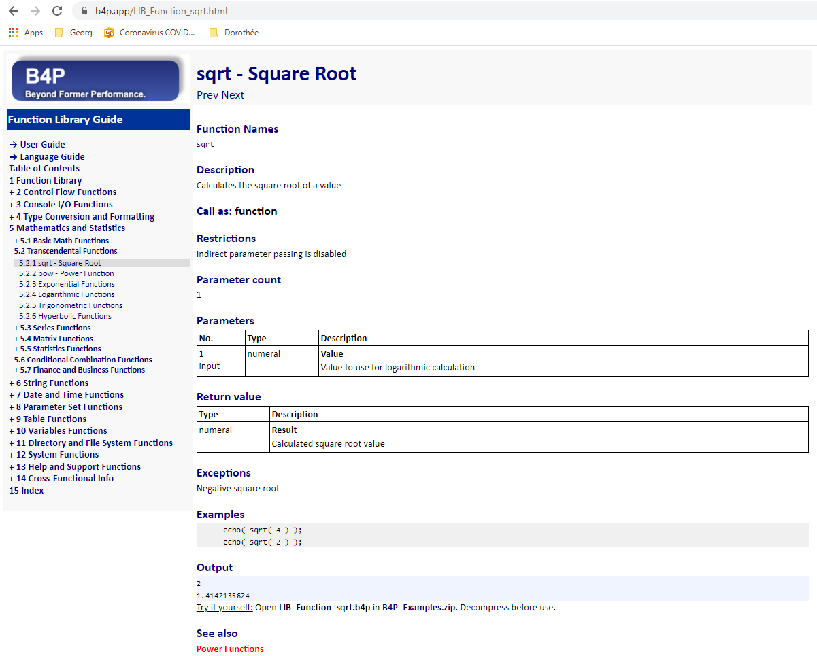
B4P Use Case Automatic documentation generation for website www.b4p.app
Inputs: Source Text (inside C program)
Output: Web contents
// sqrt
// ___________________________________________________________________________
/* B4PDOCU.START
"sqrt - Square Root" :
{
"Function Names": "sqrt",
"Keywords": "Square Root",
"Documentation": "Function Description",
"Description"::
Calculates the square root of a value
+++,
"Call as": "function",
"Parameter count": "1",
"Restrictions": "Indirect parameter passing is disabled",
"Parameters":
[
{ "Number": "1",
"Name": "Value",
"Direction": "input",
"Types": "numeral",
"Description": "Value to use for logarithmic calculation"
} ],
"Return value":
[
{ "Name": "Result",
"Types": "numeral",
"Description": "Calculated square root value"
}
],
"Exceptions": "Negative square root",
"Examples"::
echo( sqrt( 4 ) );
echo( sqrt( 2 ) );
+++,
"Output": "automatic",
"See also": "Power Functions"
}
B4PDOCU.STOP */
void function__sqrt(int bias, Token_List& p, Token_Entry& ret_val)
{
...
return;
}
Consistent structure
Clean tables
Program examples
executed automatically
Smart cross-
referencing

Slide 27
B4P Use Case Automatic Document Generation for www.b4p.app using B4P
Catalog of Books
Short Excel File
Specifies all manuals to generate
Specifies location of source text for the different manuals
Catalogue
of Books
Preparation
Preparation
Load catalogue of books
User selects the book to generate
C / C++
C / C++
Collecting all
raw texts
C / C++
Raw Inputs
Descriptions of B4P functions are documented in the C/C++ files in comments, using an enhanced JSON format.
Other contents such as introductory parts are described in additional text files, also using enhanced JSON format
C / C++ Source Code
/* ... Raw Docu inputs */
Master File
JSON
Verification
C / C++
✓
C / C++
Verification
Ensures that contents provided fulfill the structural guidelines
C / C++
Text Files
... Raw Docu inputs
Collect all keywords
Collect all Keywords
Structured handling of all keywords and function names allowing convenient cross referencing and index pages
Revolving Table of Contents
It puts all individual raw document sections into a given order and hierarchy level in the document
Both user and B4P program update this table mutually
Revolving
ToC
Load & process
Revolving ToC
Process Revolving ToC
Add titles of new contents into placeholders or at the bottom
Add further info (links, keywords)
Do chapter/section renumbering
Create HTML Navigator Bar
Generate HTML Navigation Bar
Left-hand menu to select section to see
Generate HTML contents
Formatted text and tables
Pictures included
Execute all B4P program examples automatically and add their outputs into the doc contents
Generate HTML Contents
www
@
Some icons: source: flaticon.com
Place all web
contents in
staging area
Staging Area
All files (HTML, JPG, style.css, PDF, etc.) are moved to the staging area, ready for one-mouseclick publication on the Internet: www.b4p.app
www

